Slide 1
- GOAL - Understand our ATAC-seq data by looking at the bigger picture
Latest BGI results show that the metagene profiles we get from our most recent libraries are not up to the quality expected. Only two out of twelve show decent results. This shakes up what we thought was correct, thus we need to zoom out and review precedent results to compare and find what could be the reason.

Slide 2
Alicia’s first libraries
SampleID | Date | Sample Number | Age | Ploidy | Nuclei | Tn5 | PCR cycles | Incubation time | Buffer
M2S2 | 01/12/2023 | 2 | 6dpa | 4C | 50K | 0.5 | 12 | 30 | GNB
M2S3 | 01/12/2023 | 3 | 6dpa | 4C | 50K | 0.1 | 14 | 30 | GNB
M2S4 | 01/12/2023 | 4 | 6dpa | 4C | 50K | 0.05 | 15 | 30 | GNB
M3S2 | 01/17/2023 | 2 | 6dpa | 4C | 50K | 0.2 | 10 | 30 | GNB
M3S5 | 01/17/2023 | 5 | 9dpa | 4C | 50K | 0.2 | 12 | 30 | GNB
M4S1 | 01/19/2023 | 1 | 6dpa | 4C | 50K | 0.2 | 14 | 20 | GNB
M4S2 | 01/19/2023 | 2 | 6dpa | 4C | 50K | 0.2 | 14 | 10 | GNB
M4S5 | 01/19/2023 | 5 | 6dpa | 8C | 50K | 0.2 | 14 | 10 | GNB
M5S1 | 01/26/2023 | 1 | 9dpa | 2C | 53K | 0.2 | 13 | 20 | GNB
M5S2 | 01/26/2023 | 2 | 9dpa | 4C | 55K | 0.2 | 13 | 20 | GNB
M5S5 | 01/26/2023 | 5 | 9dpa | 2C | 55K | 0.2 | 13 | 20 | Partek
M5S6 | 01/26/2023 | 6 | 9dpa | 4C | 55K | 0.2 | 13 | 20 | Partek

Slide 3
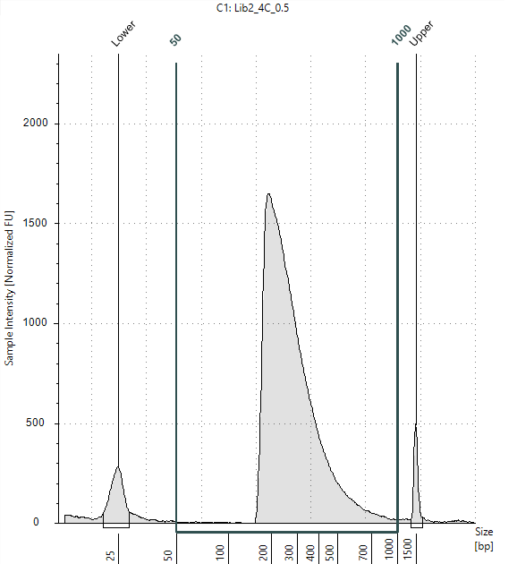
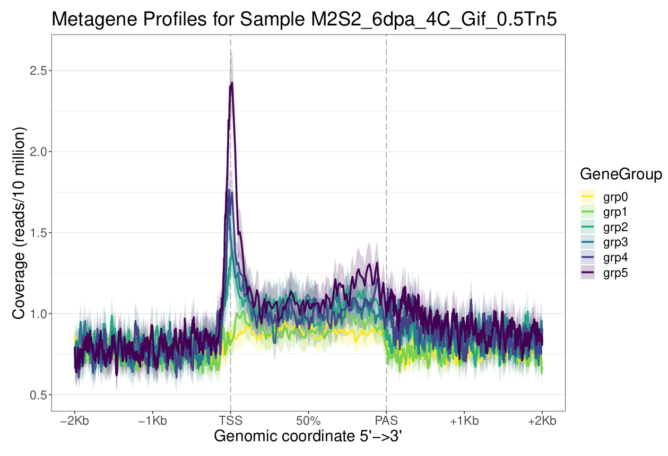
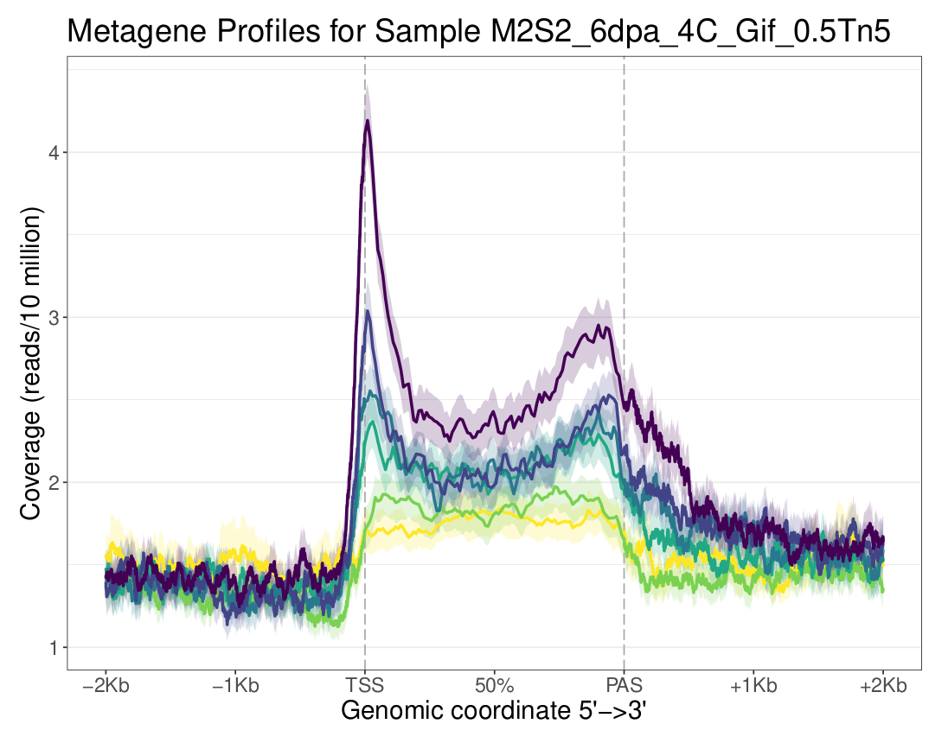
M2S2
4C
Buffer | GIF
nuclei | 50k
Tn5 | 0.5
PCR cycles | 12
Incubation | 30
Shaking | 300
Small frags
Whole
156-238 frags | 25200
286-386 frags | 8710
456-586 frags | 1420
% unimap | 3.7

Slide 4
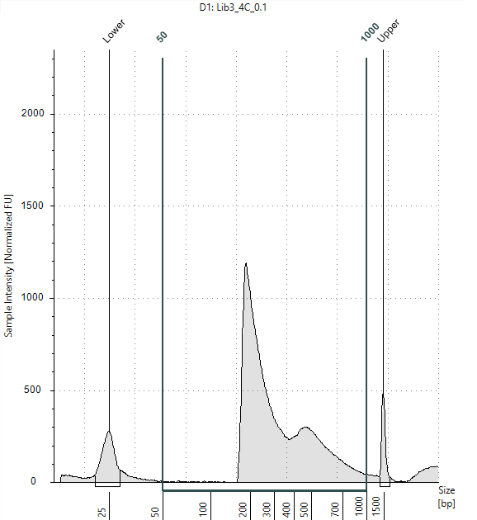
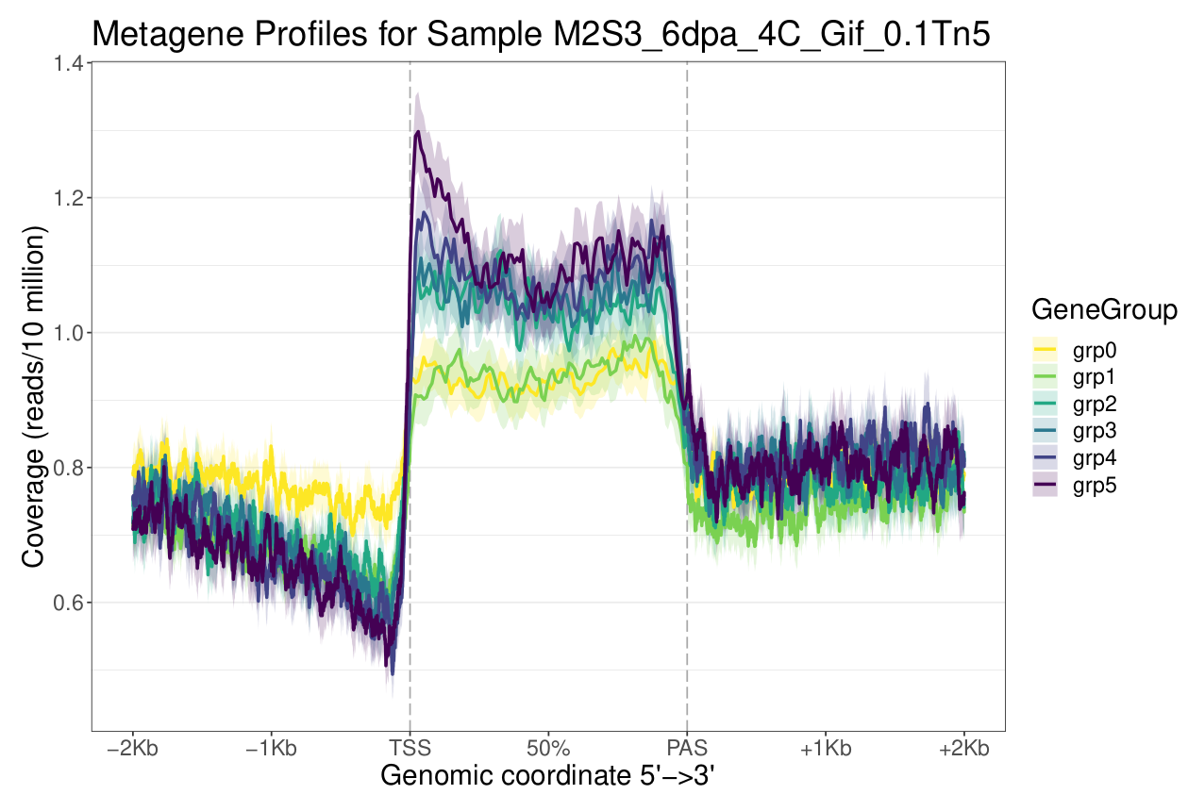
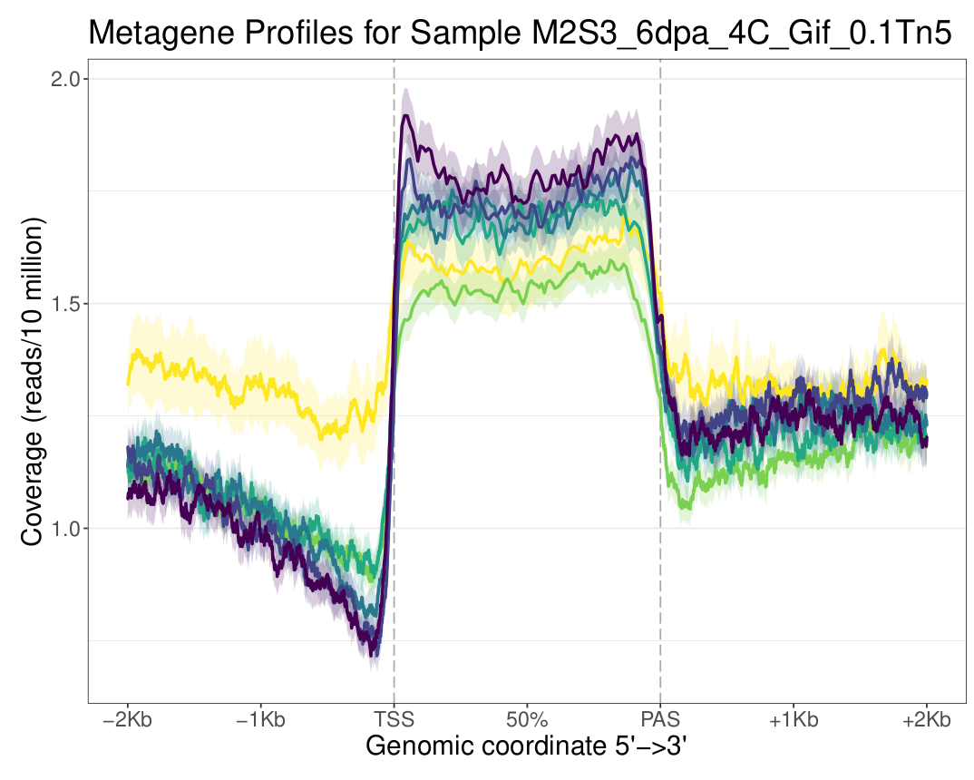
M2S3
4C
Buffer | GIF
nuclei | 50k
Tn5 | 0.1
PCR cycles | 14
Incubation | 30
Shaking | 300
Small frags
Whole
156-238 frags | 15700
286-386 frags | 3290
456-586 frags | 1920
% unimap | 13

Slide 5
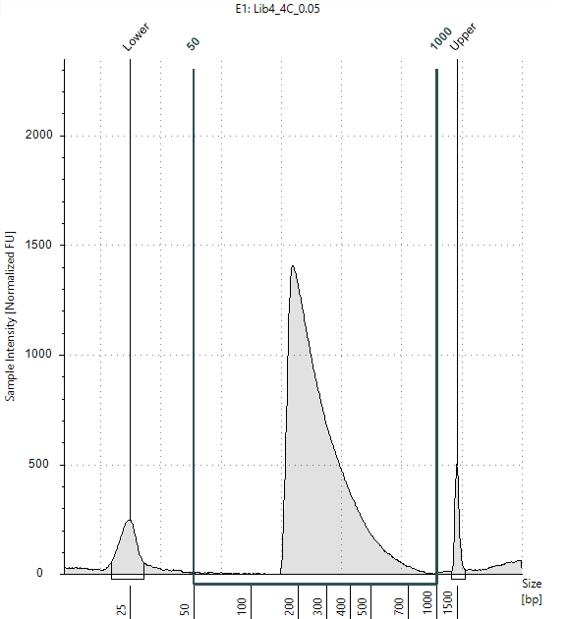
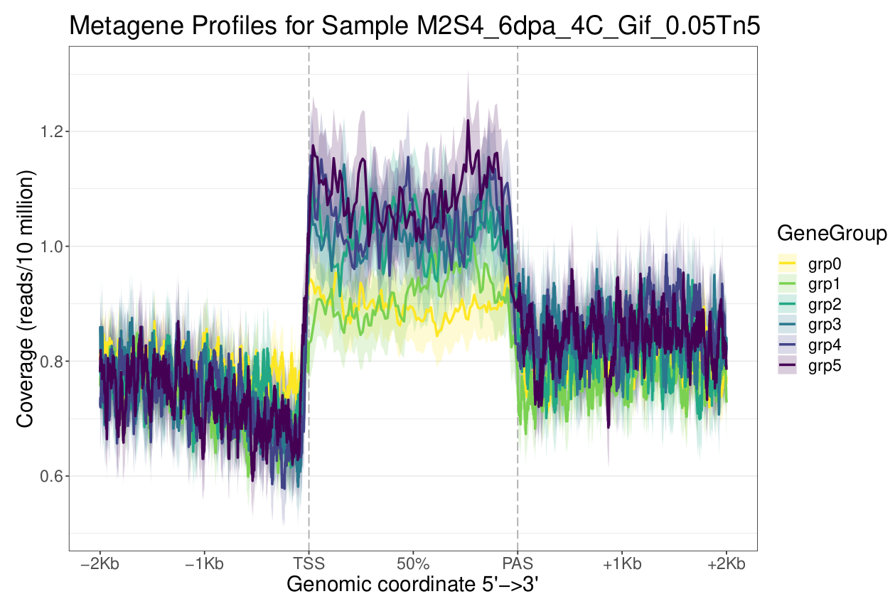
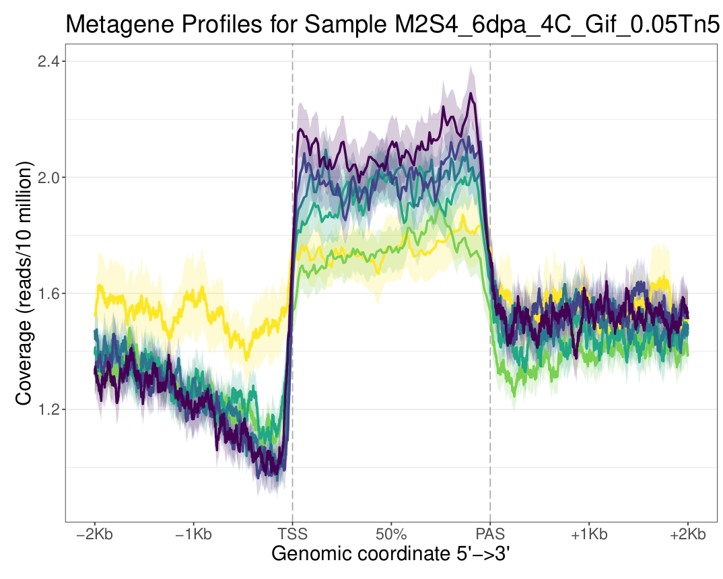
M2S4
4C
Buffer | GIF
nuclei | 50k
Tn5 | 0.05
PCR cycles | 15
Incubation | 30
Shaking | 300
Small frags
Whole
156-238 frags | 22500
286-386 frags | 6460
456-586 frags | 1280
% unimap | 7.9

Slide 6
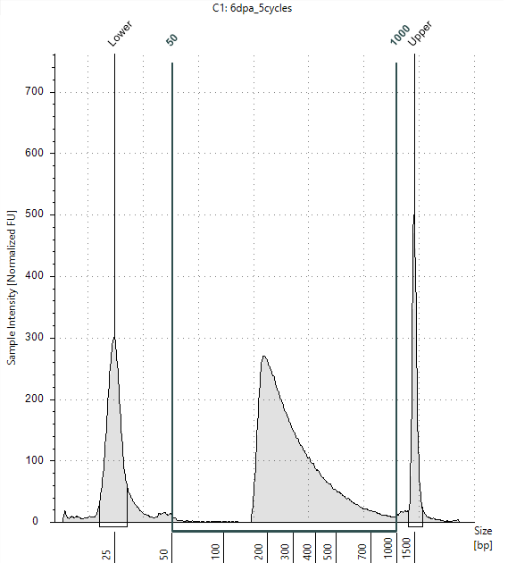
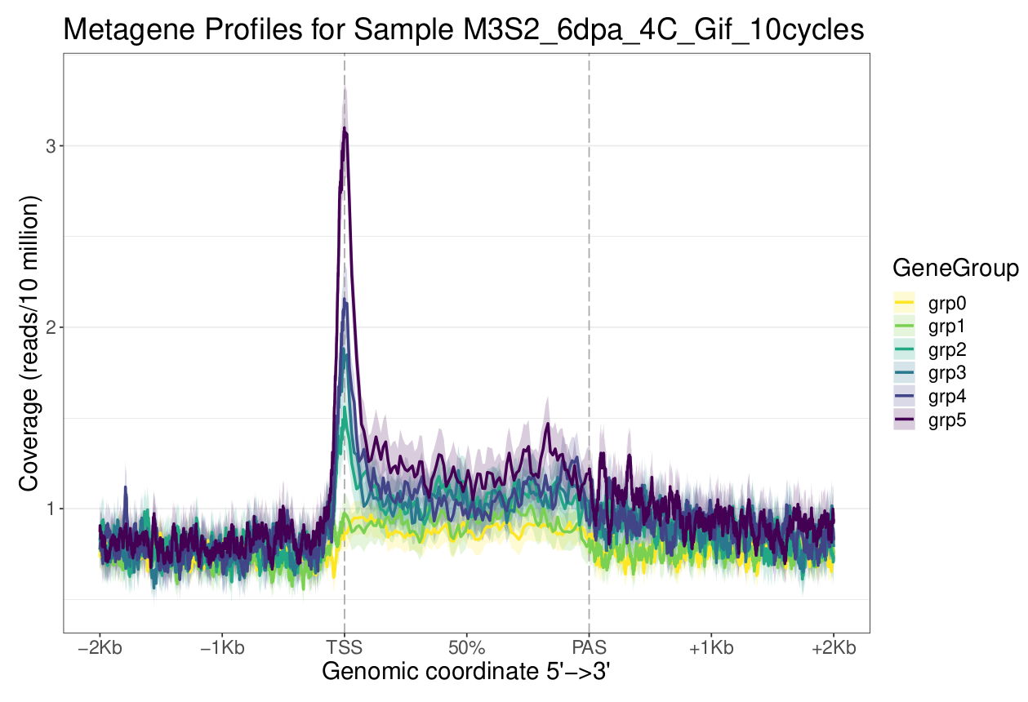
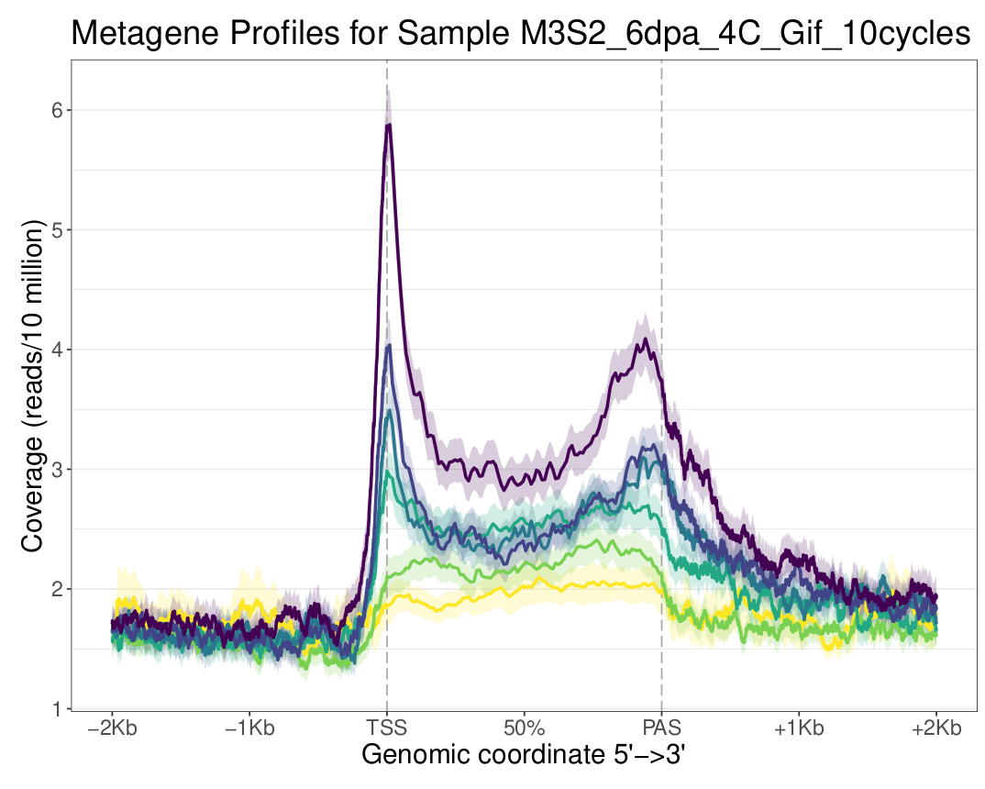
M3S2
4C
Buffer | GIF
nuclei | 50k
Tn5 | 0.2
PCR cycles | 10
Incubation | 30
Shaking | 300
Small frags
Whole
156-238 frags | 3580
286-386 frags | 1250
456-586 frags | 323
% unimap | 2.2

Slide 7
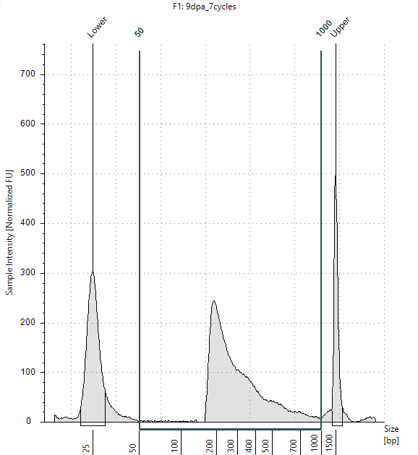
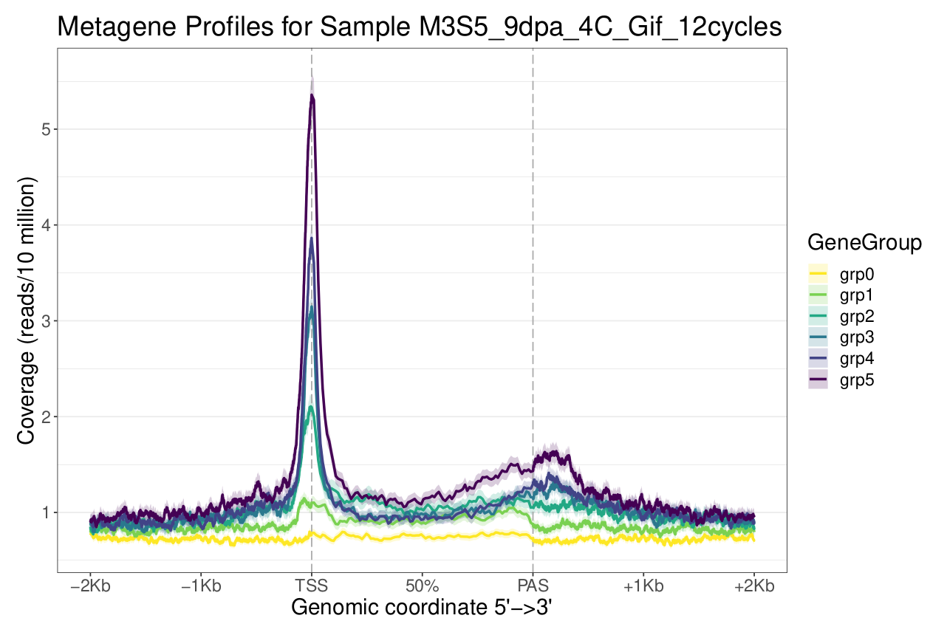
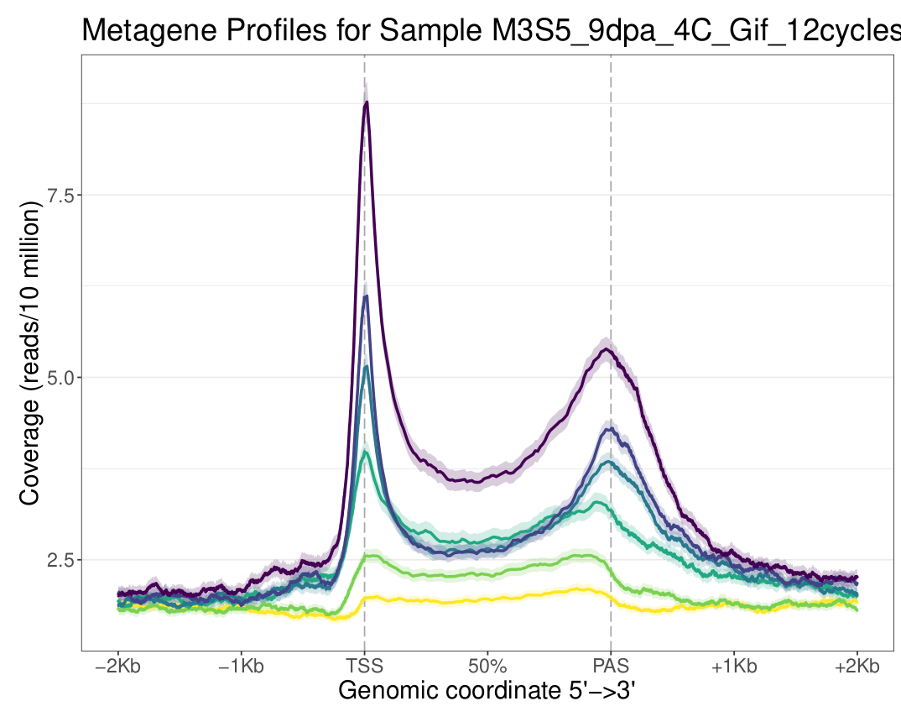
M3S5
4C
Buffer | GIF
nuclei | 50k
Tn5 | 0.2
PCR cycles | 12
Incubation | 30
Shaking | 300
Small frags
Whole
156-238 frags | 2850
286-386 frags | 888
456-586 frags | 245
% unimap | 21.5

Slide 8
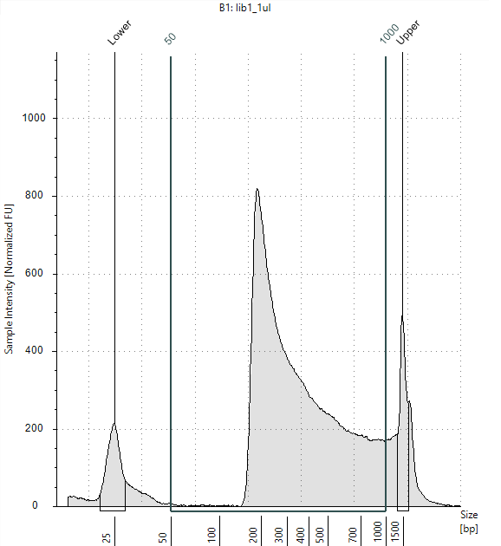
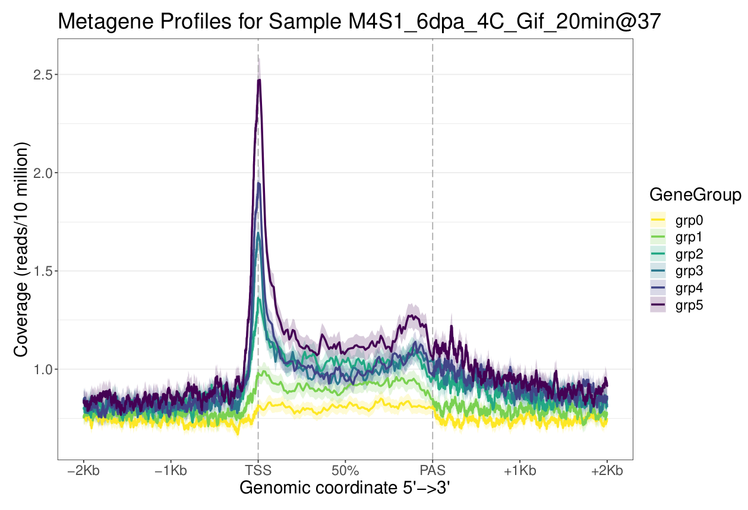
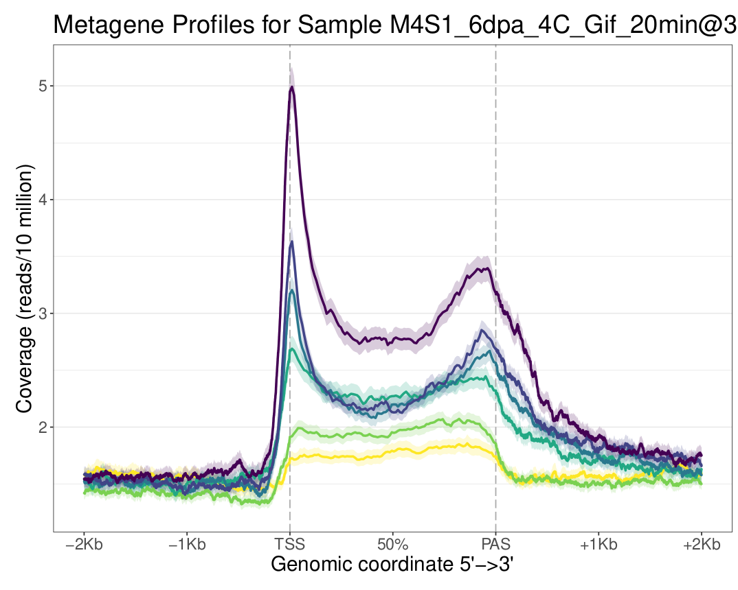
M4S1
4C
Buffer | GIF
nuclei | 50k
Tn5 | 0.2
PCR cycles | 14
Incubation | 20
Shaking | 300
Small frags
Whole
156-238 frags | 7520
286-386 frags | 2540
456-586 frags | 1090
% unimap | 16.3

Slide 9
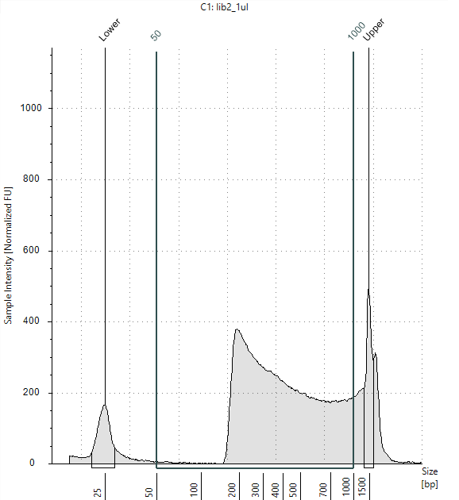
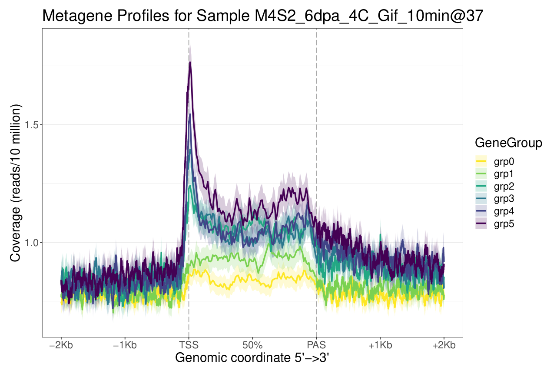
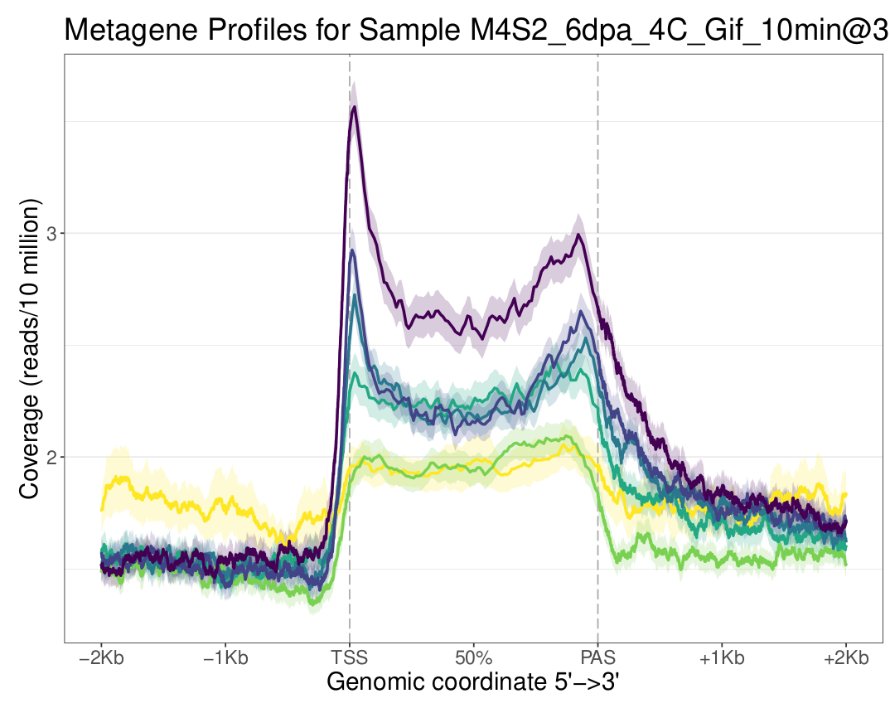
M4S2
4C
Buffer | GIF
nuclei | 50k
Tn5 | 0.2
PCR cycles | 14
Incubation | 10
Shaking | 300
Small frags
Whole
156-238 frags | 3660
286-386 frags | 1820
456-586 frags | 922
% unimap | 7.2

Slide 10
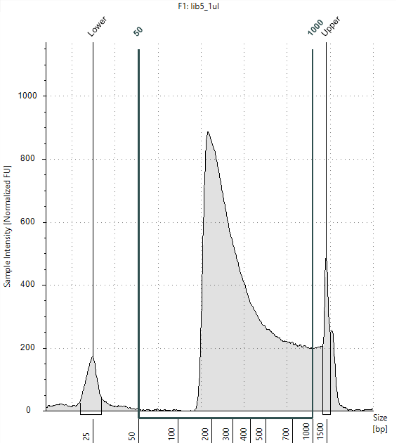
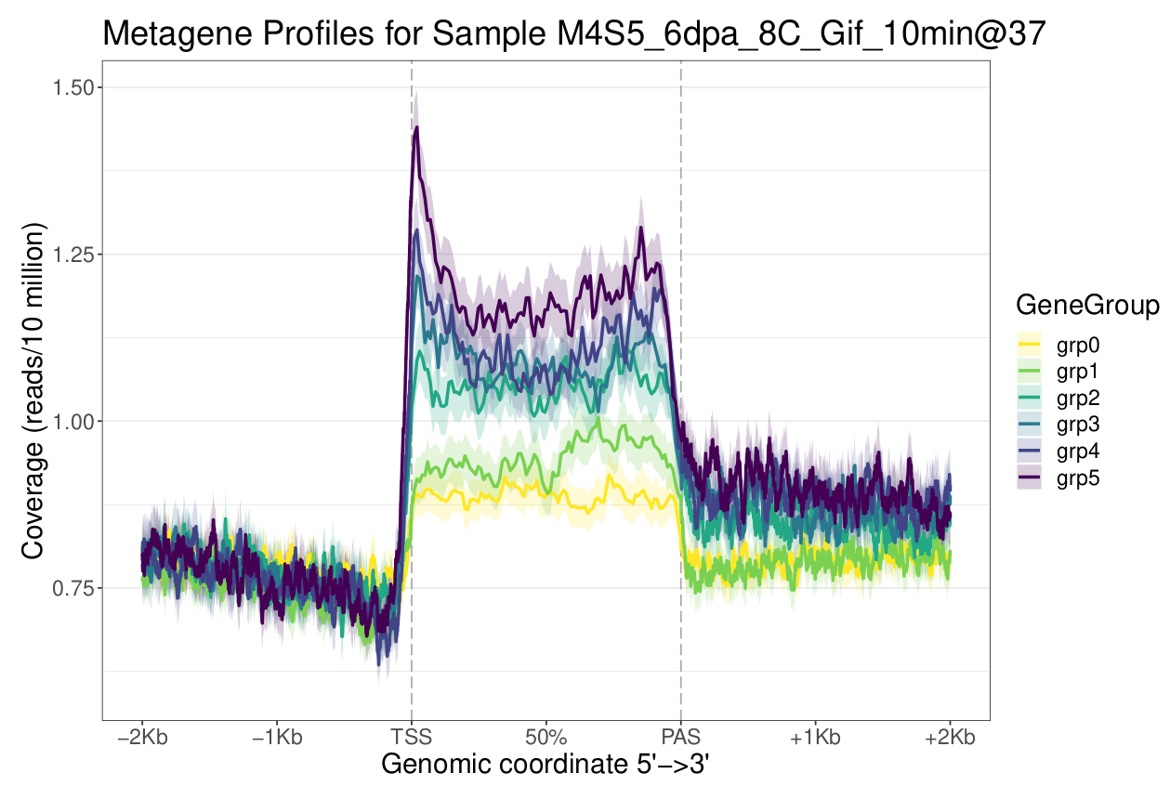
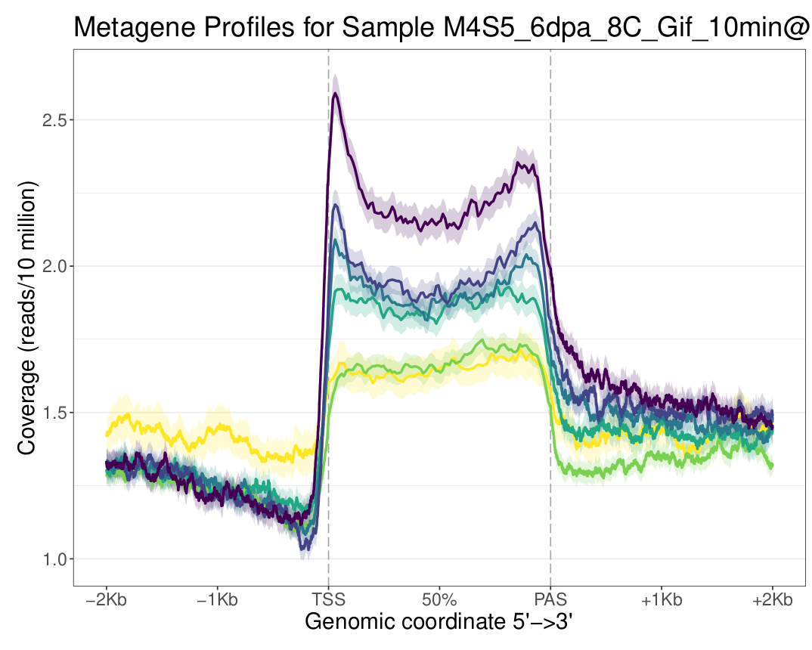
M4S5
8C
Buffer | GIF
nuclei | 50k
Tn5 | 0.2
PCR cycles | 14
Incubation | 10
Shaking | 300
Small frags
Whole
156-238 frags | 10300
286-386 frags | 3600
456-586 frags | 1310
% unimap | 19.3

Slide 11
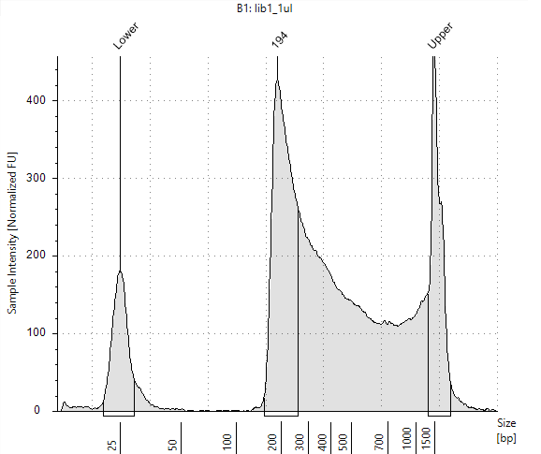
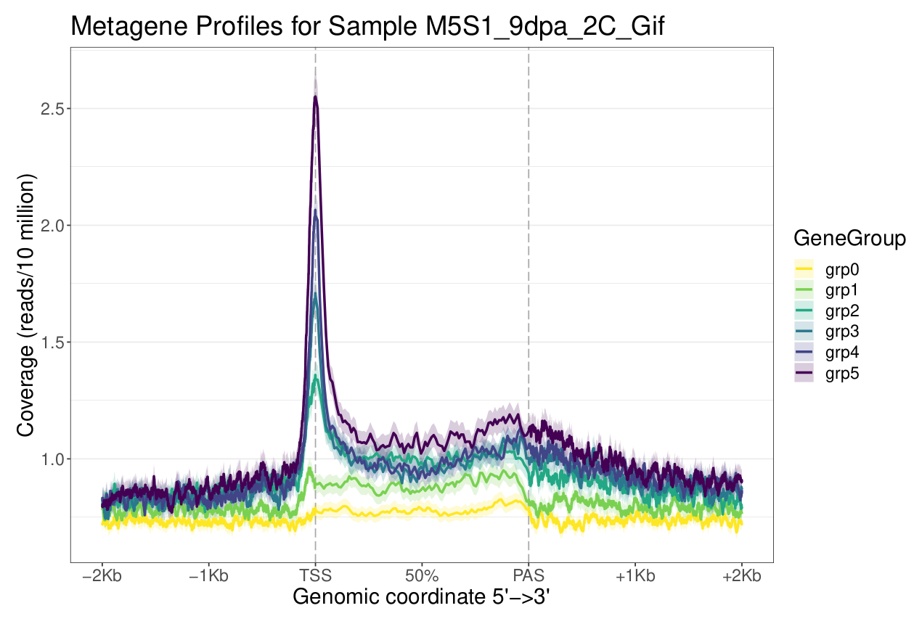
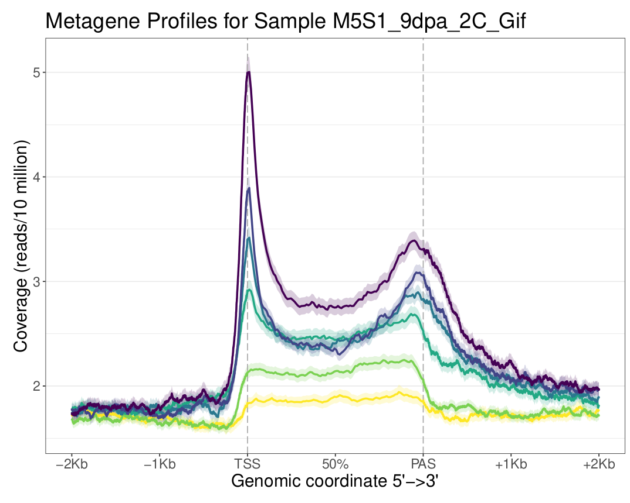
M5S1
2C
Buffer | GIF
nuclei | 53k
Tn5 | 0.2
PCR cycles | 13
Incubation | 20
Shaking | 300
Small frags
Whole
156-238 frags | 2820
286-386 frags | 1040
456-586 frags | 473
% unimap | 17.6

Slide 12
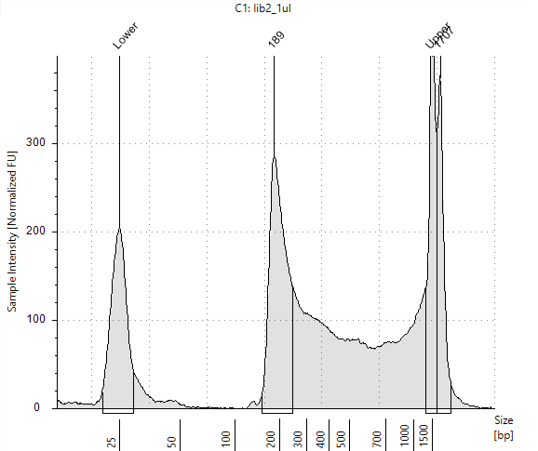
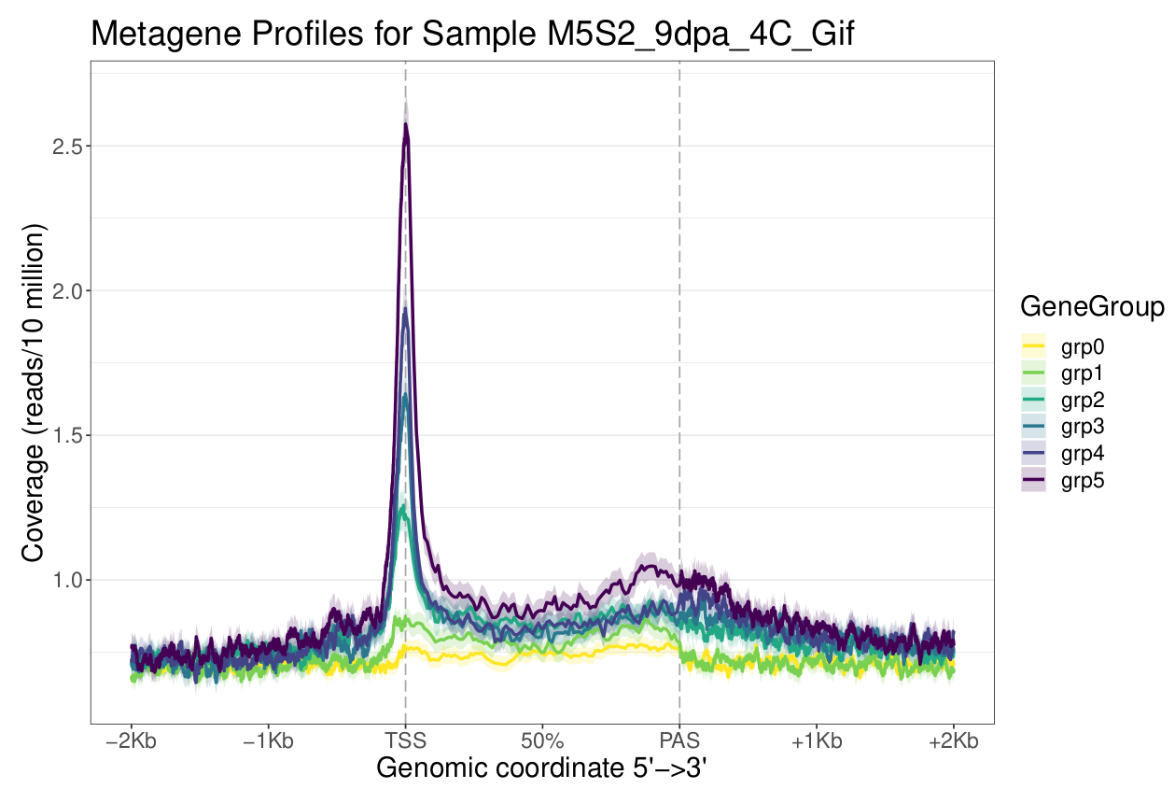
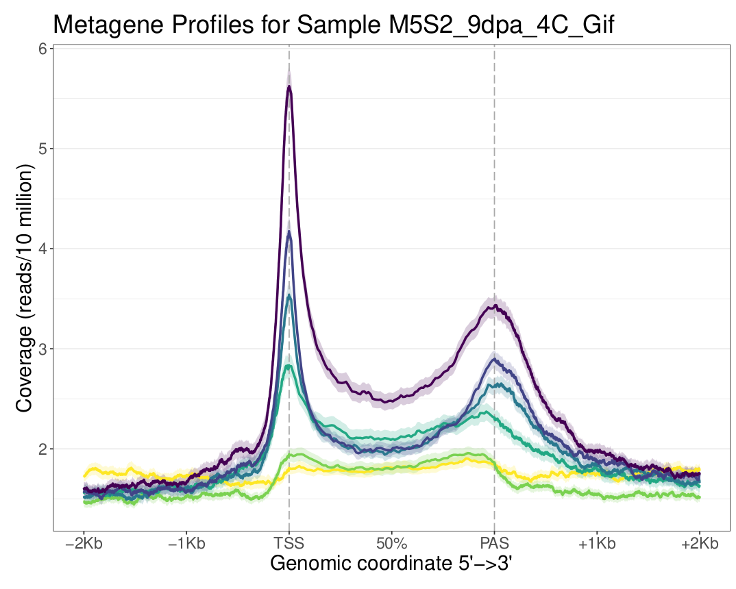
M5S2
4C
Buffer | GIF
nuclei | 55k
Tn5 | 0.2
PCR cycles | 13
Incubation | 20
Shaking | 300
Small frags
Whole
156-238 frags | 2730
286-386 frags | 761
456-586 frags | 381
% unimap | 25.7

Slide 13
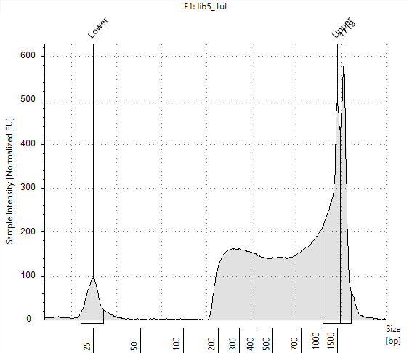
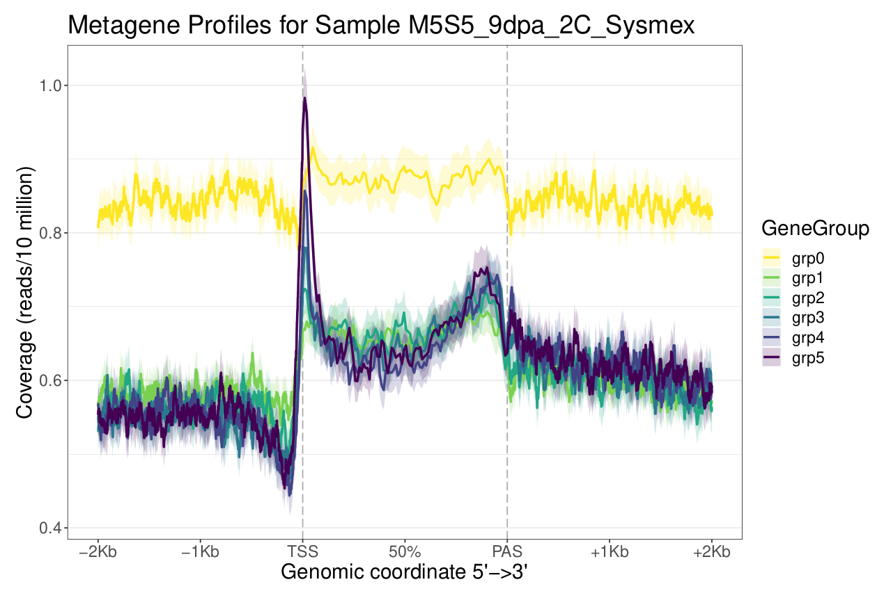
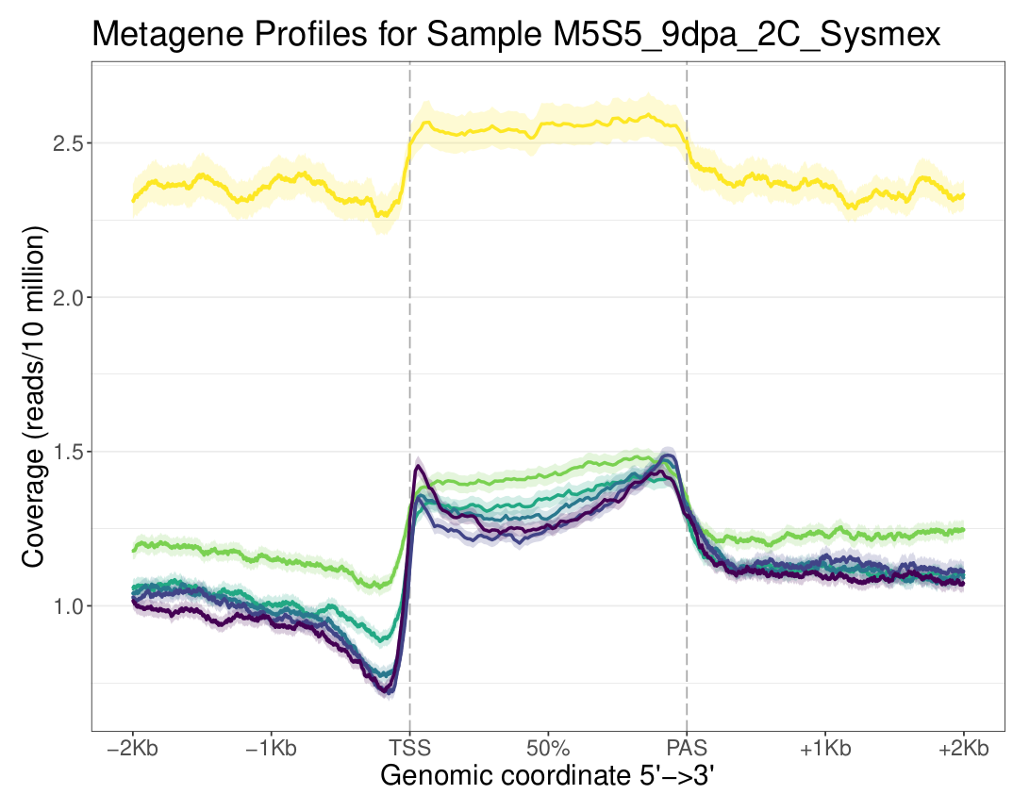
M5S5
2C
Buffer | Partek
nuclei | 55k
Tn5 | 0.2
PCR cycles | 13
Incubation | 20
Shaking | 300
Small frags
Whole
156-238 frags | 568
286-386 frags | 610
456-586 frags | 370
% unimap | 34.8

Slide 14
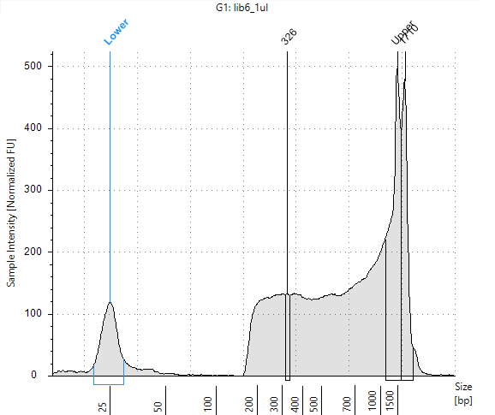
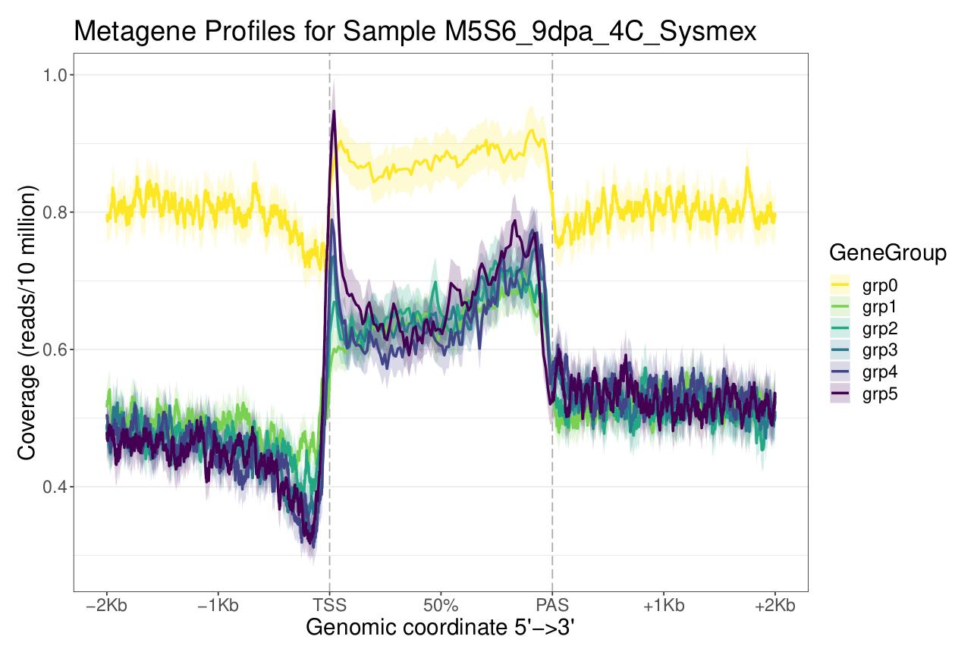
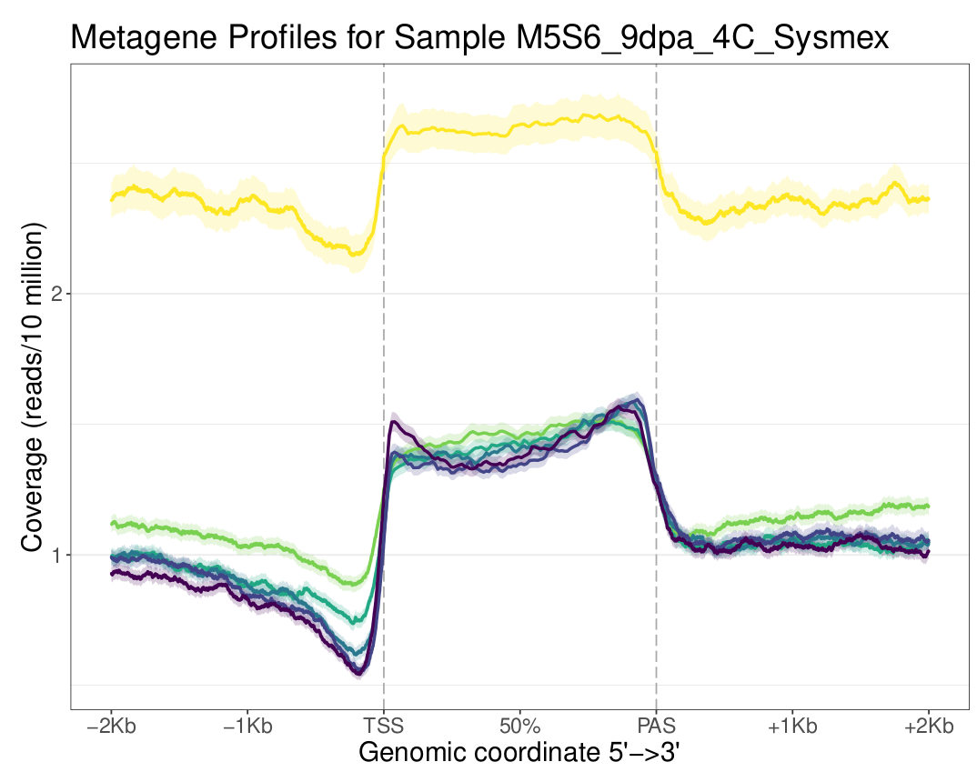
M5S6
4C
Buffer | Partek
nuclei | 55k
Tn5 | 0.2
PCR cycles | 13
Incubation | 20
Shaking | 300
Small frags
Whole
156-238 frags | 741
286-386 frags | 622
456-586 frags | 411
% unimap | 34.1

Slide 15
Alicia’s second libraries
SampleID | Date | Sort buffer | Age | Ploidy | Nuclei | Digitonin (%) | Tween20 (%) | Tn5 (µL) | PCR cycles | Incubation time (min) | Shaking (RPM) | Tagmentation Buffer
M8S3 | 07-Mar | Partec | 12 | 4C | 55 | 0.01 | 0 | 2 | 12 | 30 | 500 | Tris-DMF
M11S2 | 24-Mar | Partec | 9 | 4C | 55 | 0.05 | 0.5 | 2.5 | 9 | 30 | 1000 | TAPS-DMF
M11S4 | 24-Mar | Partec | 9 | 8C | 55 | 0 | 0 | 2.5 | 9 | 30 | 1000 | TAPS-DMF
M12S1 | 27-Mar | Gif | 9 | 4C | 55 | 0 | 0 | 0.2 | 12 | 30 | 1000 | TAPS-DMF
M12S2 | 27-Mar | Gif | 9 | 4C | 55 | 0 | 0 | 1 | 12 | 30 | 1000 | TAPS-DMF
M12S3 | 27-Mar | Gif | 9 | 4C | 55 | 0 | 0 | 2.5 | 10 | 30 | 1000 | TAPS-DMF
M12S4 | 27-Mar | Gif | 9 | 8C | 55 | 0.05 | 0.5 | 1 | 10 | 30 | 1000 | TAPS-DMF
M12S5 | 27-Mar | Gif | 9 | 8C | 55 | 0.05 | 0.5 | 2.5 | 10 | 30 | 1000 | TAPS-DMF
M12S6 | 27-Mar | Gif | 9 | 16C | 55 | 0.05 | 0.5 | 2.5 | 10 | 30 | 1000 | TAPS-DMF
M12S7 | 27-Mar | Partec | 9 | 4C | 55 | 0 | 0 | 2.5 | 10 | 30 | 1000 | TAPS-DMF
M12S8 | 27-Mar | Partec | 9 | 4C | 55 | 0.05 | 0.5 | 2.5 | 10 | 30 | 1000 | TAPS-DMF
M12S9 | 27-Mar | Partec | 9 | 8C | 55 | 0.05 | 0.5 | 2.5 | 10 | 30 | 1000 | TAPS-DMF

Slide 16
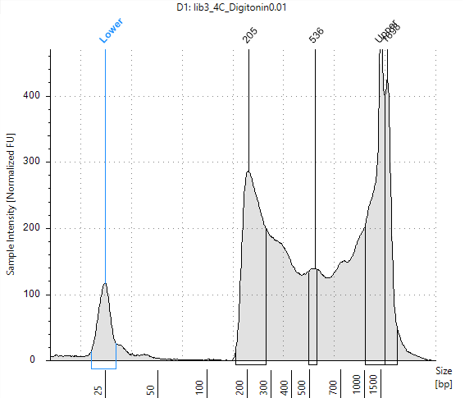
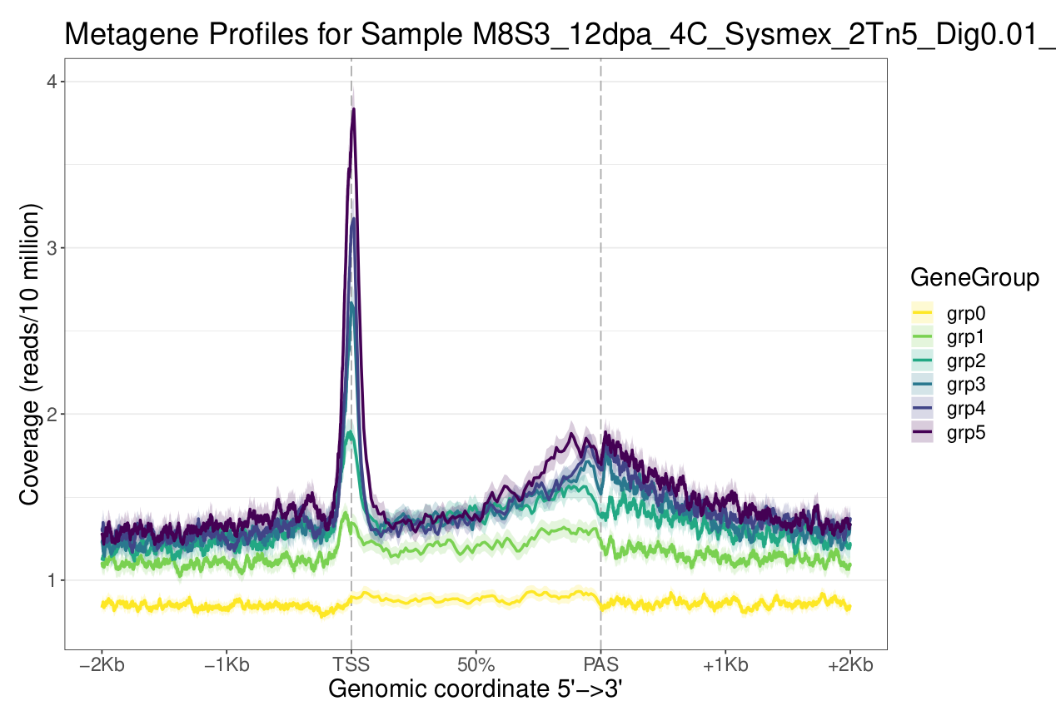
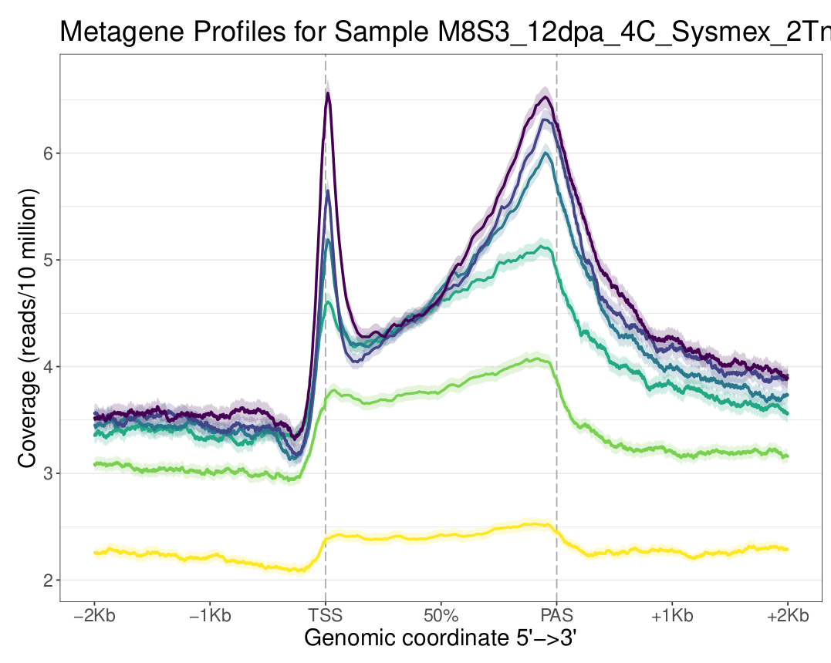
M8S3
4C
Buffer | Partec
nuclei | 55k
Tn5 | 2
PCR cycles | 12
Incubation | 30
Shaking | 500
Small frags
Whole
156-238 frags | 1270
286-386 frags | 704
456-586 frags | 340
% unimap | 23

Slide 17
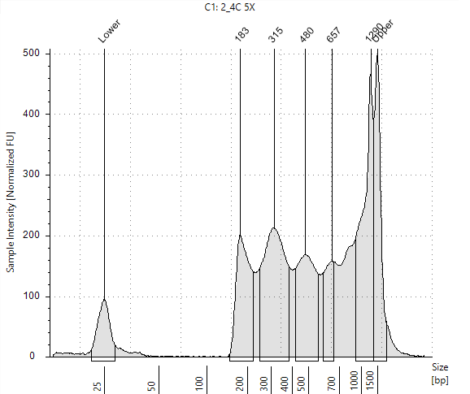
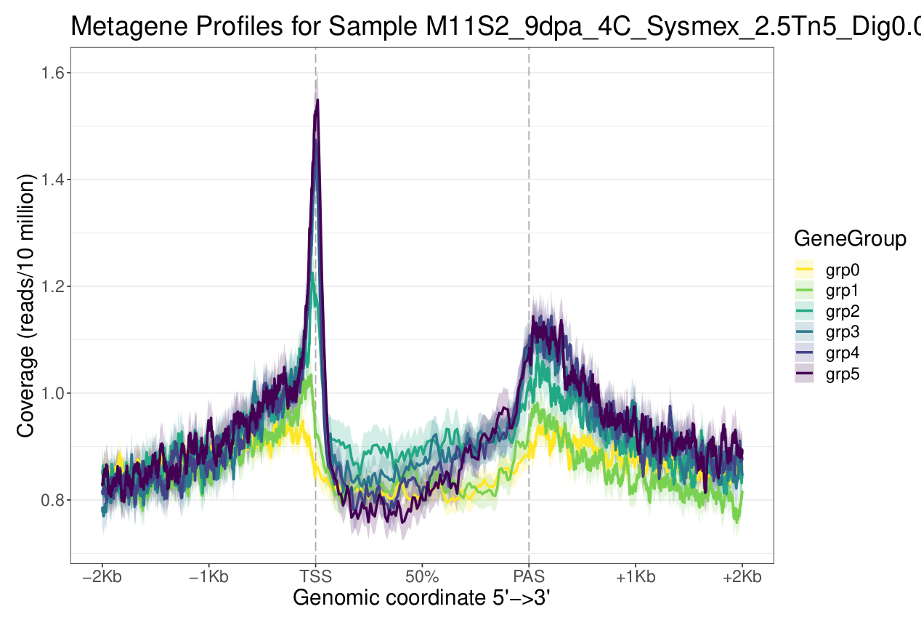
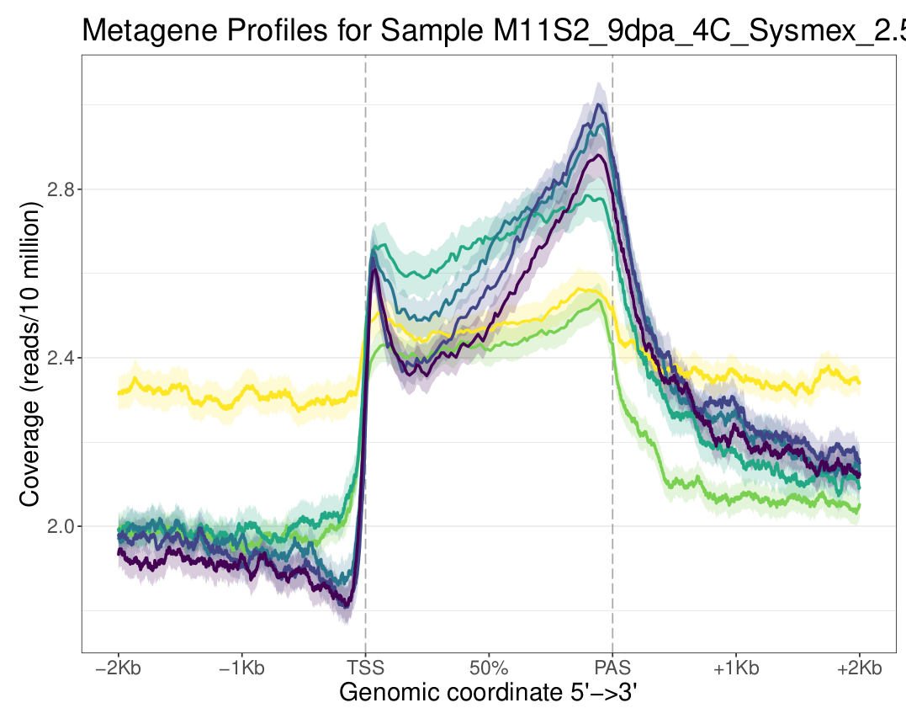
M11S2
4C
Buffer | Partec
nuclei | 55k
Tn5 | 2.5
PCR cycles | 9
Incubation | 30
Shaking | 1000
Small frags
Whole
156-238 frags | 1880
286-386 frags | 1260
456-586 frags | 630
% unimap | 41.1

Slide 18
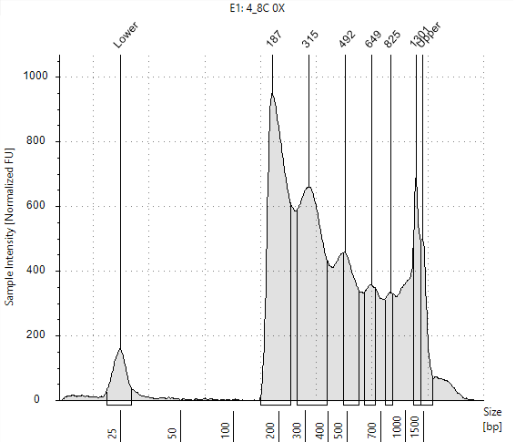
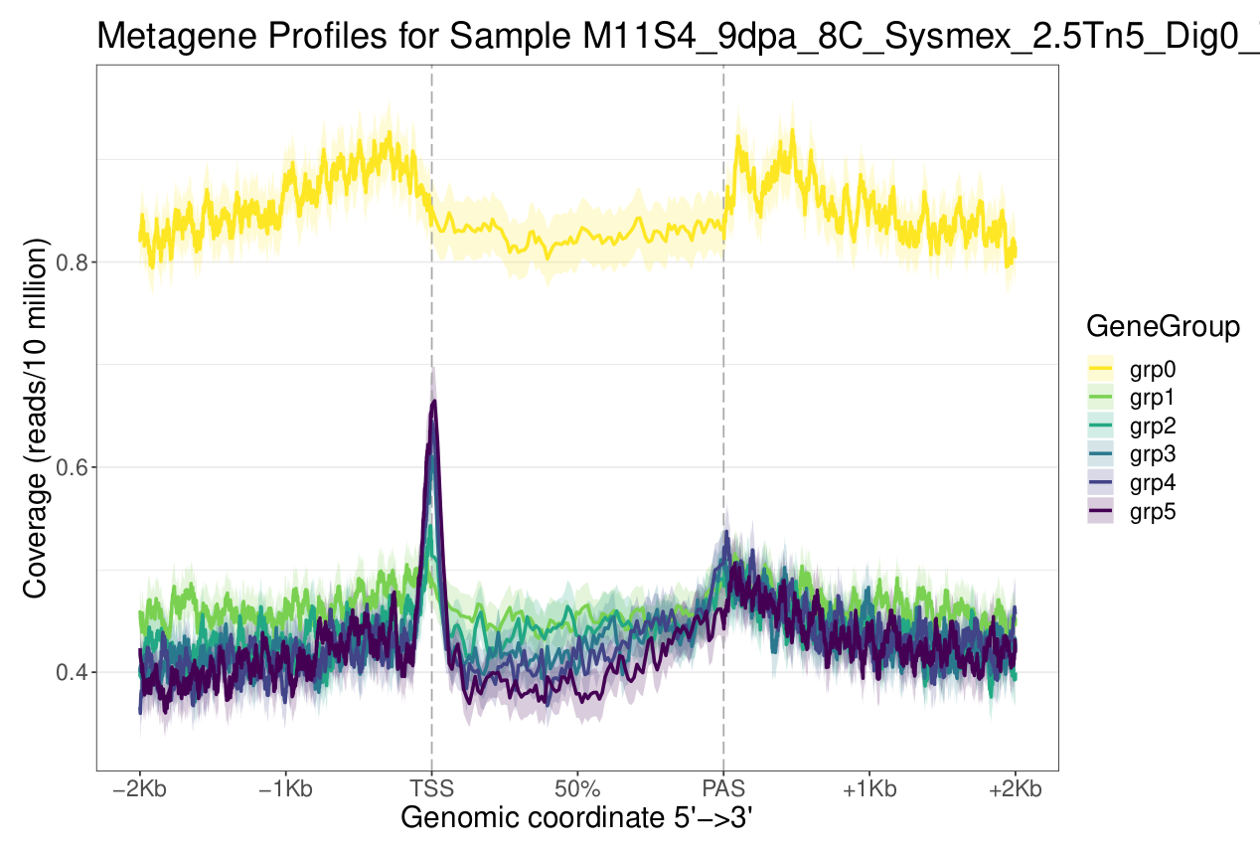
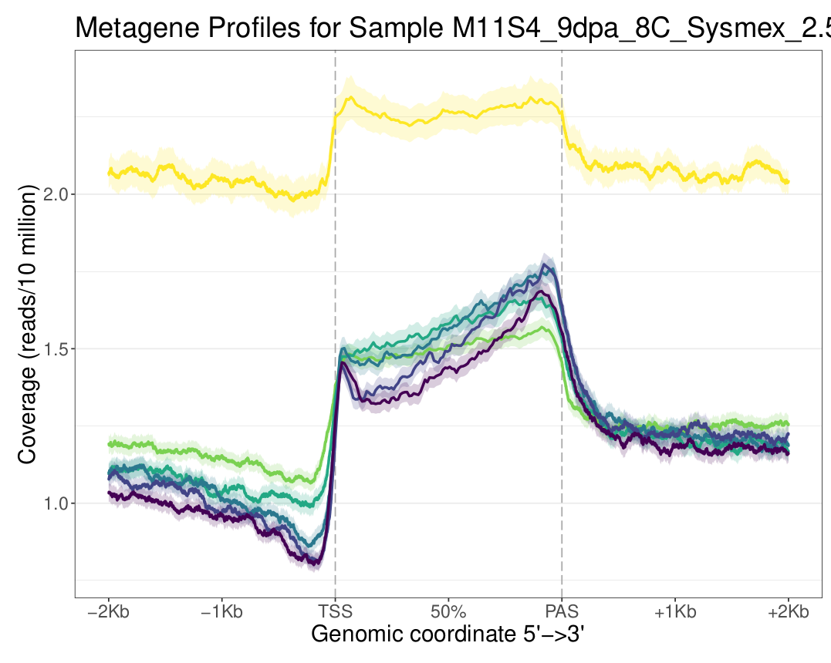
M11S4
8C
Buffer | Partec
nuclei | 55k
Tn5 | 2.5
PCR cycles | 9
Incubation | 30
Shaking | 1000
Small frags
Whole
156-238 frags | 9940
286-386 frags | 4610
456-586 frags | 1960
% unimap | 39.5

Slide 19
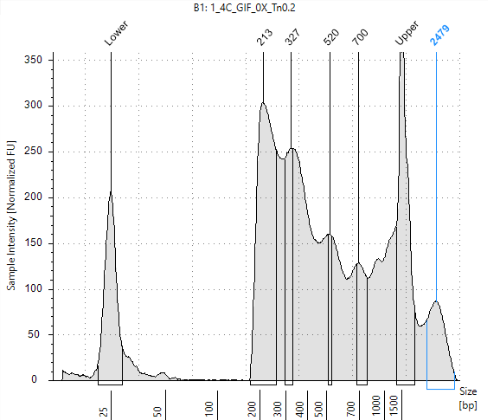
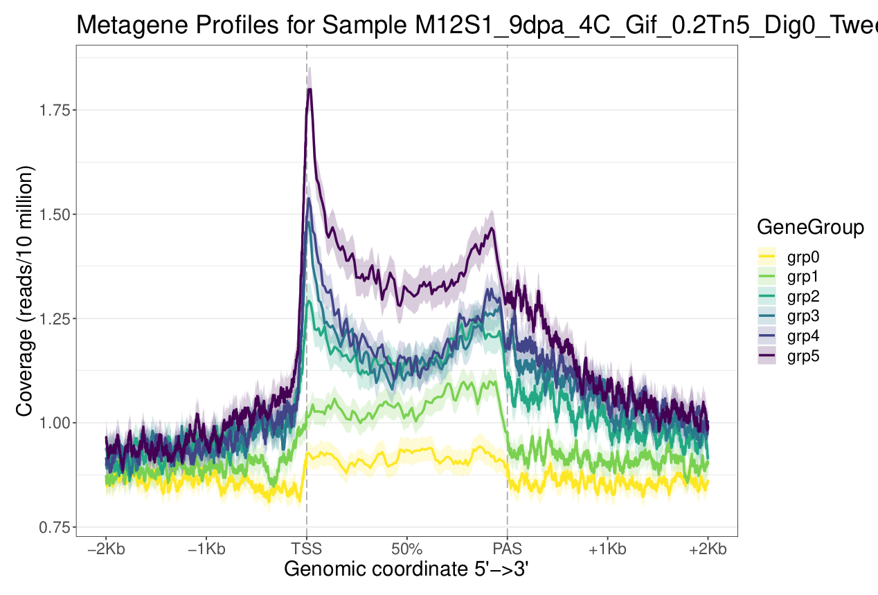
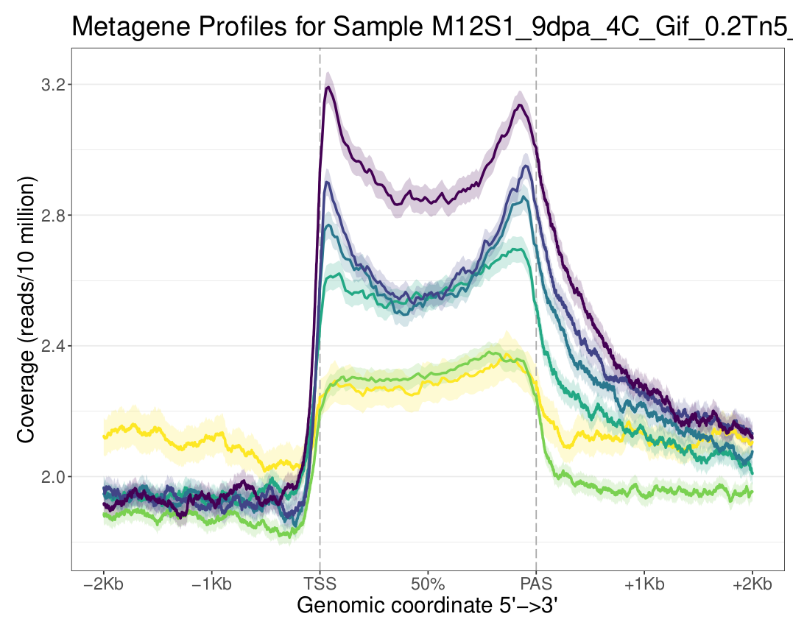
M12S1
4C
Buffer | Gif
nuclei | 55k
Tn5 | 0.2
PCR cycles | 12
Incubation | 30
Shaking | 1000
Small frags
Whole
156-238 frags | 1640
286-386 frags | 1390
456-586 frags | 543
% unimap | 34.8

Slide 20
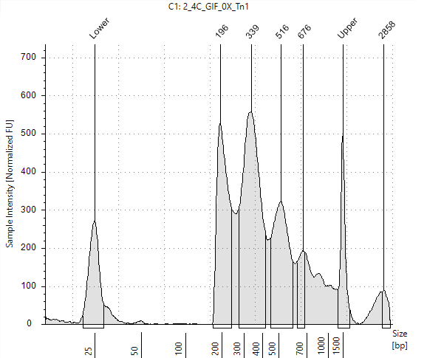
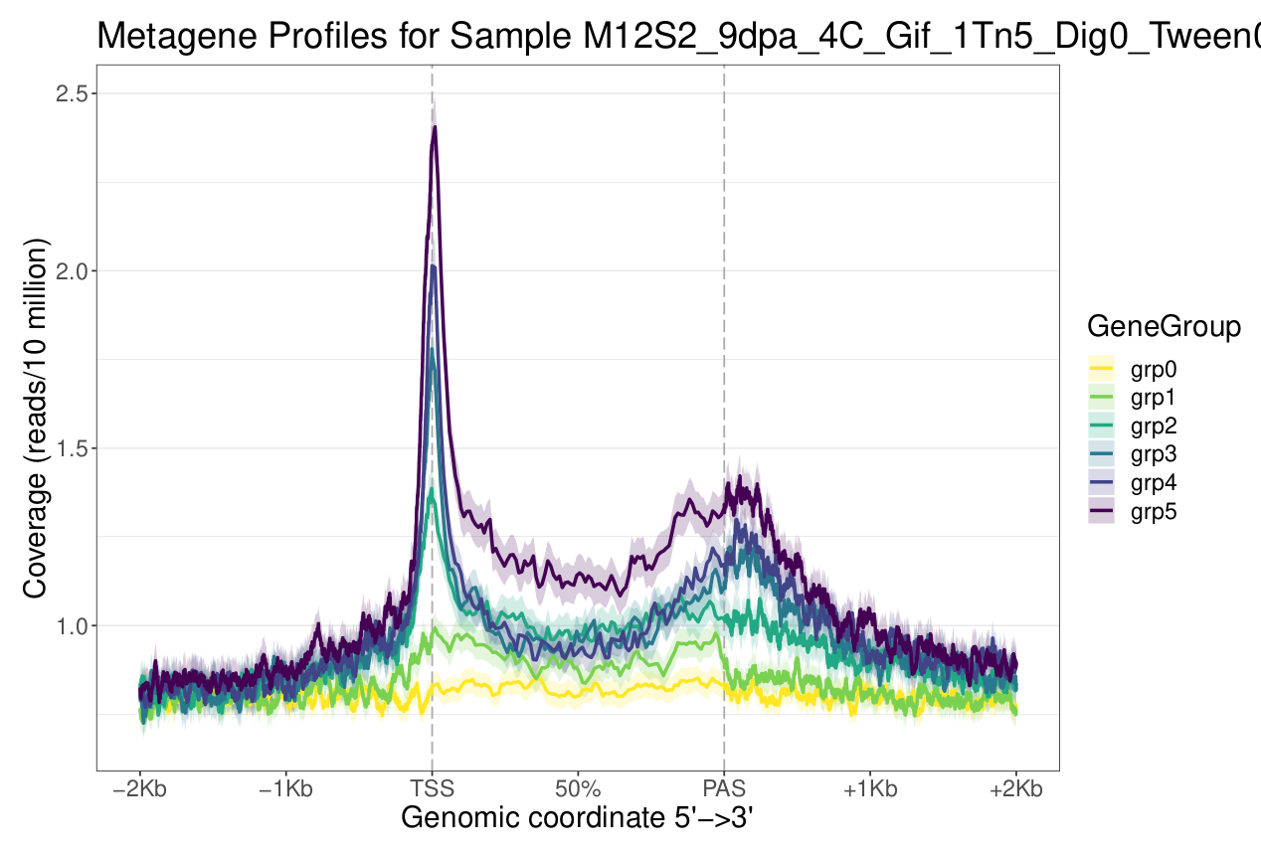

M12S2
4C
Buffer | Gif
nuclei | 55k
Tn5 | 1
PCR cycles | 12
Incubation | 30
Shaking | 1000
Small frags
Whole
156-238 frags | 4720
286-386 frags | 4170
456-586 frags | 1540
% unimap | 34.7

Slide 21



M12S3
4C
Buffer | Gif
nuclei | 55k
Tn5 | 2.5
PCR cycles | 10
Incubation | 30
Shaking | 1000
Small frags
Whole
156-238 frags | 1320
286-386 frags | 1060
456-586 frags | 500
% unimap | 36.3

Slide 22



M12S4
8C
Buffer | Gif
nuclei | 55k
Tn5 | 1
PCR cycles | 10
Incubation | 30
Shaking | 1000
Small frags
Whole
156-238 frags | 2400
286-386 frags | 2450
456-586 frags | 1050
% unimap | 38.2

Slide 23



M12S5
8C
Buffer | Gif
nuclei | 55k
Tn5 | 2.5
PCR cycles | 10
Incubation | 30
Shaking | 1000
Small frags
Whole
156-238 frags | 6820
286-386 frags | 5060
456-586 frags | 1910
% unimap | 31.9

Slide 24



M12S6
16C
Buffer | Gif
nuclei | 55k
Tn5 | 2.5
PCR cycles | 10
Incubation | 30
Shaking | 1000
Small frags
Whole
156-238 frags | 11200
286-386 frags | 7130
456-586 frags | 1330
% unimap | 42.6

Slide 25



M12S7
4C
Buffer | Partec
nuclei | 55k
Tn5 | 2.5
PCR cycles | 10
Incubation | 30
Shaking | 1000
Small frags
Whole
156-238 frags | 5390
286-386 frags | 4310
456-586 frags | 1270
% unimap | 40.3

Slide 26



M12S8
4C
Buffer | Partec
nuclei | 55k
Tn5 | 2.5
PCR cycles | 10
Incubation | 30
Shaking | 1000
Small frags
Whole
156-238 frags | 2800
286-386 frags | 1980
456-586 frags | 796
% unimap | 37.4

Slide 27



M12S9
8C
Buffer | Partec
nuclei | 55k
Tn5 | 2.5
PCR cycles | 10
Incubation | 30
Shaking | 1000
Small frags
Whole
156-238 frags | 8730
286-386 frags | 5960
456-586 frags | 1660
% unimap | 37.7

Slide 28

Ulysse’s libraries

Slide 29



Lib2
4C
Buffer | GIF
nuclei | 55k
Tn5 | 0.2
PCR cycles | 13
Incubation | 20
Shaking | 500
Small frags
Whole
456-586 frags | 1.24
286-386 frags | 3.05
156-238 frags | 10.7
% unimap | 12.1

Slide 30



Lib4
16C
Buffer | GIF
nuclei | 55k
Tn5 | 0.2
PCR cycles | 13
Incubation | 20
Shaking | 500
Small frags
Whole
456-586 frags | 2.9
286-386 frags | 10.3
156-238 frags | 36.8
% unimap | 15.6

Slide 31



Lib5
2C
Buffer | GIF
nuclei | 55k
Tn5 | 0.2
PCR cycles | 14
Incubation | 25
Shaking | 500
Small frags
Whole
456-586 frags | 1.23
286-386 frags | 7.14
156-238 frags | 137
% unimap | 36.2

Slide 32



Lib8
16C
Buffer | GIF
nuclei | 55k
Tn5 | 0.2
PCR cycles | 14
Incubation | 25
Shaking | 500
Small frags
Whole
456-586 frags | 4.27
286-386 frags | 11.9
156-238 frags | 42.8
% unimap | 25.8

Slide 33



Lib10_D+T
4C
Buffer | GIF
nuclei | 55k
Tn5 | 0.2
PCR cycles | 14
Incubation | 25
Shaking | 500
Small frags
Whole
456-586 frags | 0.79
286-386 frags | 4.55
156-238 frags | 53.14
% unimap | 34.6

Slide 34



Lib11
4C
Buffer | GIF
nuclei | 55k
Tn5 | 0.2
PCR cycles | 14
Incubation | 25
Shaking | 500
Small frags
Whole
456-586 frags | 0.81
286-386 frags | 3.12
156-238 frags | 22.8
% unimap | 32.1

Slide 35



Lib16
32C
Buffer | GIF
nuclei | 30k
Tn5 | 0.3
PCR cycles | 13
Incubation | 25
Shaking | 500
Small frags
Whole
456-586 frags | 1.57
286-386 frags | 4.26
156-238 frags | 19.4
% unimap | 30

Slide 36



Lib17
2C
Buffer | GIF
nuclei | 55k
Tn5 | 0.2
PCR cycles | 13
Incubation | 25
Shaking | 500
Small frags
Whole
456-586 frags | 0.53
286-386 frags | 2.21
156-238 frags | 59
% unimap | 35.7

Slide 37



Lib18
4C
Buffer | GIF
nuclei | 55k
Tn5 | 0.2
PCR cycles | 13
Incubation | 25
Shaking | 500
Small frags
Whole
456-586 frags | 0.42
286-386 frags | 1.35
156-238 frags | 29
% unimap | 32.8

Slide 38



Lib19
2C
Buffer | GIF
nuclei | 55k
Tn5 | 0.2
PCR cycles | 13
Incubation | 25
Shaking | 500
Small frags
Whole
456-586 frags | 1.86
286-386 frags | 6.38
156-238 frags | 22.6
% unimap | 24.5

Slide 39



Lib23
4C
Buffer | GIF
nuclei | 55k
Tn5 | 0.2
PCR cycles | 13
Incubation | 25
Shaking | 500
Small frags
Whole
456-586 frags | 1.49
286-386 frags | 5.7
156-238 frags | 39.4
% unimap | 33.9

Slide 40



Lib24
8C
Buffer | GIF
nuclei | 55k
Tn5 | 0.2
PCR cycles | 13
Incubation | 25
Shaking | 500
Small frags
Whole
456-586 frags | 2.95
286-386 frags | 10.7
156-238 frags | 63.8
% unimap | 29.7

